Slide 1
Final project
Computer information and tecnology

Slide 2
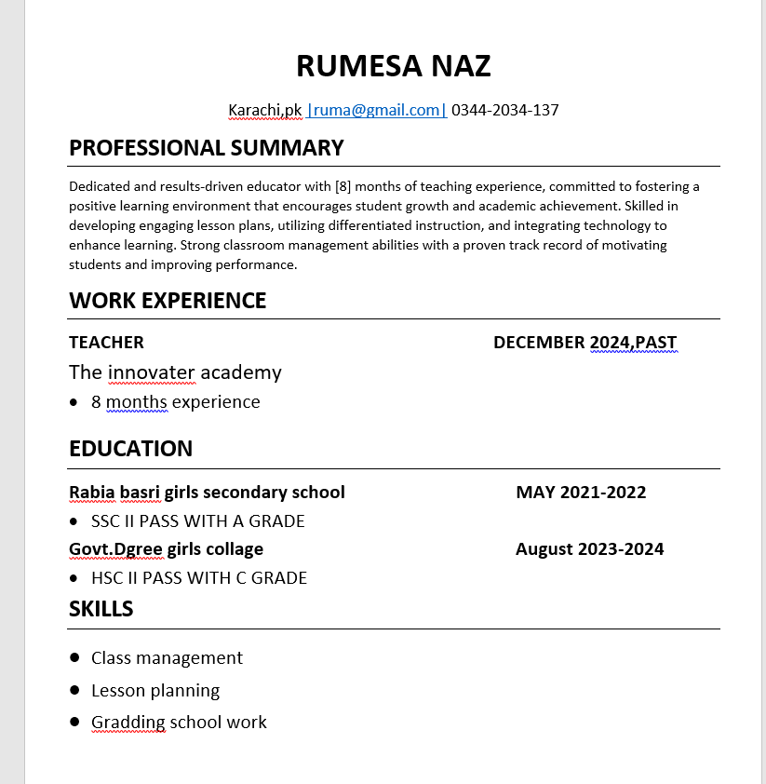
My Resume This resume highlights teaching experience,education and skills in classroom management. If reflects her passion for engaging students and improving their learning outcomes

Slide 3
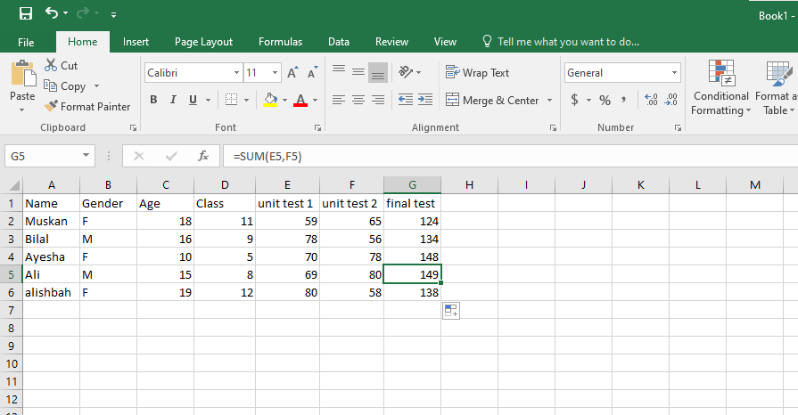
Sum in Excel the sum function in excel used to quickly add up number in range

Slide 4
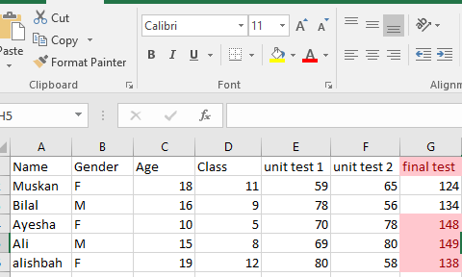
Conditional formatting highlights cells based on specific rules or condition.

Slide 5
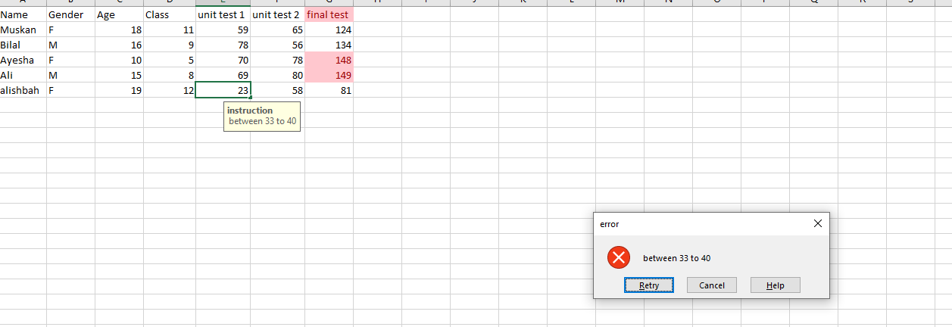
Data validation controls the type of data or value entered into a cell.

Slide 6
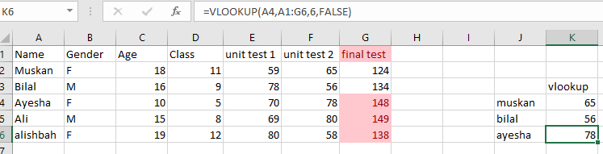
Vlookup in excel is used to find and retrieve data fram a specific colume in a table.

Slide 7
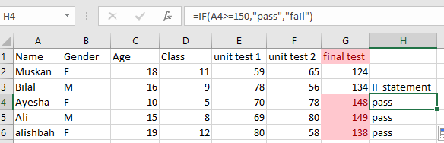
If statement checks a condition and returns one value if true and another is false.

Slide 8
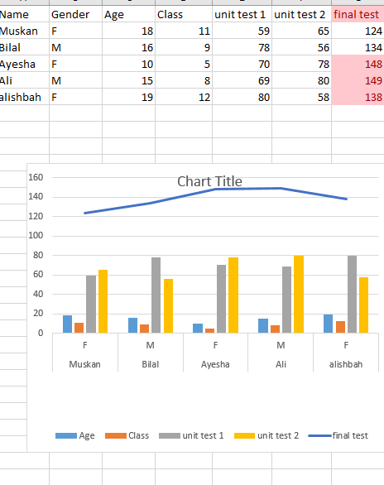
Chart in excel chart in excel represent data for easy understanding they help identify trends patterns quickly.

Slide 9
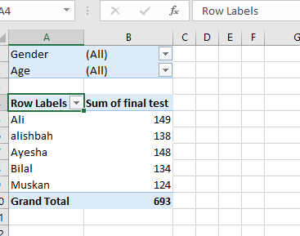
Pivot table pivot table summarize and analyze large amounts of data they help organize,group and compare information easily.

